Slide 1
INTRO TO CSS

Slide 2
INTRO TO CSS
Covered in this lesson:
  Overview
    What is CSS?
    Why to use CSS?
    CSS for Skinning your Website
  Structure
    CSS Syntax Introduction
    Three places CSS can be defined
    CSS Syntax Specifics
    Cascading Inheritance

Slide 3
WHAT IS CSS?
CSS ("Cascading Style Sheets") determines how the elements in our XHTML documents are displayed and formatted.
By using CSS, we separate the content of a web page from the presentation (format and styling) of that content.
CSS enables us to make all pages of our website look similar and consistent.
The power of CSS is that it allows us to make site-wide formatting changes by making edits to a single file.
In this course, we will be learning version 2.1 of CSS. A newer version, known as CSS3, is being increasingly adopted by web designers and web browser manufacturers.

Slide 4
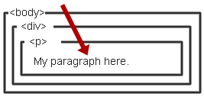
WHAT IS CSS?
Cascading Style Sheet
    Stylesheet Language
      Standards-based set of properties and attributes to define styles
    To describe the presentation a document written in a
    ‘markup language’ like HTML or XML
      Markup encoding: <p>My paragraph here.</p>
      Defines the style of how things in <p> tags appear.
      Font, color, size, margins, etc.
    Cascading
      Rules to determine how to
      apply markup that contains
      other markup

Slide 5
WHAT DOES "CASCADING" MEAN?
We use the term "cascading" because there is an established order of priority to resolve formatting conflicts:
Inline style (highest priority)
Internal style sheet (second priority)
External style sheet (third priority)
Web browser default (only if not defined elsewhere)
For each XHTML element, the browser will see which styles are defined inline and from internal and external style sheets. For any conflicts detected, it will use this priority system to determine which format to display on the page.
In the prior example, the heading text would display in the color specified by the inline style, which outranks all the others.
If multiple, conflicting styles are defined in the same style sheet, only the final one will be applied. Be careful, as this is another common mistake committed by beginners.

Slide 6
WHY CSS?
Separate Content from Form
  Content is the text and images, marked up to define regions of specific types
  Form defines the “style” for the content
<font size=“14px”>
My First Header
</font>
<font size=“12px” color=“red” face=“Verdana”>
My information 1 goes here.
</font>
<font size=“14px”>
My Second Header
</font>
<font size=“12px” color=“red” face=“Verdana”>
Different information goes here.
</font>
The old way:

Slide 7
WHY CSS? CONTINUED.
Separate Content from Form
  Content
  Form or Style
<p class=“header”>My First Header</p>
<p class=“info”>My Information 1 goes here</p>
<p class=“header”>My Second Header</p>
<p class=“info”>Different Information goes here</p>
(Specific markup properties like Class will be discussed later).
.header { font-size:14px;}
.info { font-family: verdana;
font-color: blue;
font-size: 12px; }

Slide 8
WHAT DOES THIS SEPARATION GET US?
Separate Content from Form
  Specify the style once for every instance of that class.
    Example: Specify the font once for all text on the HTML page that you’ve identified as a “header”.
  The stylesheet can be a separate file which all HTML pages on your entire site can link to.
    Only have to specify the style once for your ENITRE SITE
  Can change the style for your entire site by editing only ONE FILE.

Slide 9
CSS SKINNING
“Skinning” - changing the look of a page or your site
  Selecting an appearance by choosing which stylesheet to use.
<link rel="stylesheet" type="text/css" href=“skin1.css" />
<p class=“info”>My Information 1 goes here</p>
+
skin1.css
.info { background-color: White;
font-family: Verdana;
font-color: Blue; }
=
Some information goes here.

Slide 10
CSS SKINNING 2
“Skinning” - changing the look of a page or your site
  Selecting an appearance by choosing which stylesheet to use.
<link rel="stylesheet" type="text/css" href=“skin2.css" />
<p class=“info”>My Information 1 goes here</p>
+
skin1.css
.info { background-color: Blue;
font-family: Serif;
font-color: White; }
=
Some information goes here.

Slide 11
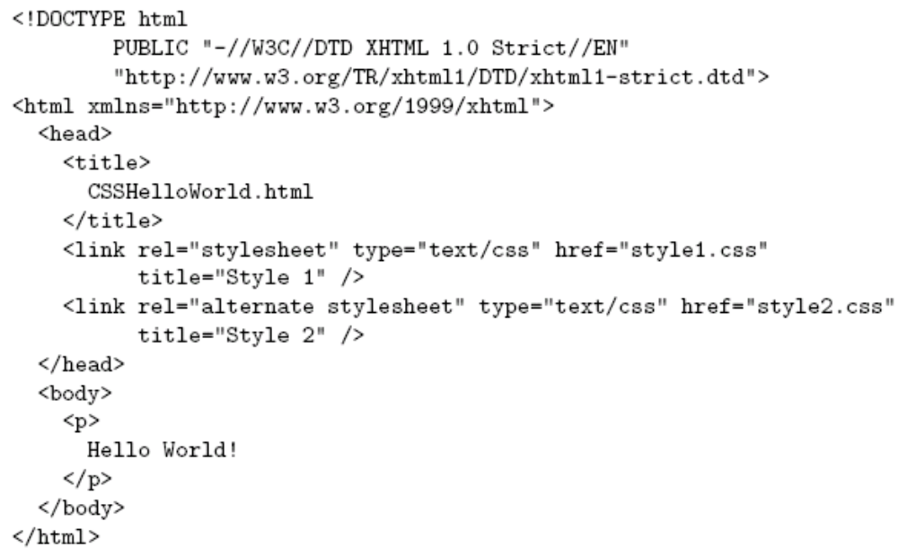
CSS INTRODUCTION
link element associates style sheet with doc.
Guy-Vincent Jourdan :: CSI 3140 :: based on Jeffrey C. Jackson’s slides

Slide 12
CSS INTRODUCTION
type attribute specifies style language used
Guy-Vincent Jourdan :: CSI 3140 :: based on Jeffrey C. Jackson’s slides

Slide 13
CSS INTRODUCTION
href attribute provides style sheet URL
Guy-Vincent Jourdan :: CSI 3140 :: based on Jeffrey C. Jackson’s slides

Slide 14
CSS INTRODUCTION
title attribute provides style sheet name
Guy-Vincent Jourdan :: CSI 3140 :: based on Jeffrey C. Jackson’s slides

Slide 15
CSS INTRODUCTION
Alternative, user selectable style sheets
can be specified
Guy-Vincent Jourdan :: CSI 3140 :: based on Jeffrey C. Jackson’s slides

Slide 16
THREE WAYS TO USE CSS
We can add CSS code in any combination of three different ways:
Inline Style - CSS code is placed directly into an XHTML element within the <body> section of a web page.
Internal Style Sheet - CSS code is placed into a separate, dedicated area within the <head> section of a web page.
External Style Sheet - CSS code is placed into a separate computer file and then linked to a web page.
Let's take a look now at examples of each of these methods.

Slide 17
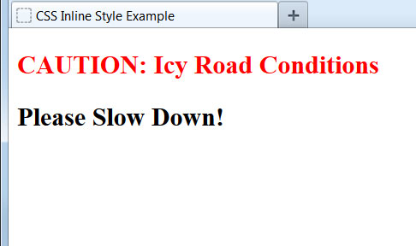
INLINE STYLE
To define an inline CSS style, we simply add the style attribute to an XHTML element with the CSS declaration as the attribute value:
<h2 style="color:red;">CAUTION: Icy Road Conditions</h2>
<h2>Please Slow Down!</h2>
An inline style declaration is highly specific and formats just one element on the page. No other elements, including other <h2> elements on the page, will be affected by this CSS style.
Since inline styles have limited scope and do not separate content from presentation, their use is generally discouraged. We won't be using inline styles much in this class.

Slide 18
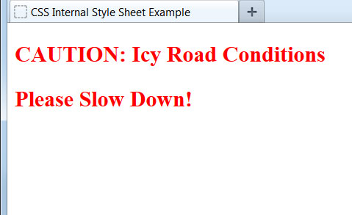
INTERNAL STYLE SHEET
To use an internal CSS style sheet, we add a <style> section within the <head> of the page. All our CSS declarations go within this section:
<head>
...
<style type="text/css">
h2 {color:red;}
</style>
</head>
<body>
<h2>CAUTION: Icy Road Conditions</h2>
<h2>Please Slow Down!</h2>
</body>
Styles declared in the internal style sheet affect all matching elements on the page. In this example, all <h2> page elements are displayed in the color red.
Since formatting declarations are entirely in the <head> section, away from the actual page content, internal CSS style sheets do a much better job than inline styles at separating content from presentation.

Slide 19
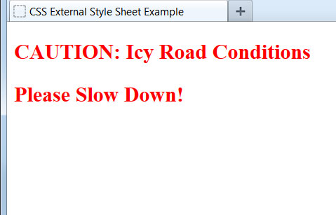
EXTERNAL STYLE SHEET
To use an external CSS style sheet, we create a new file (with a .css extension) and write our style declarations into this file. We then add a <link> element into our HTML file, right after the opening <head> tag:
style.css (separate file):
h2 {color:red;}
example.html file:
<head>
<link rel="stylesheet" type="text/css" href="style.css" />
...
</head>
<body>
<h2>CAUTION: Icy Road Conditions</h2>
<h2>Please Slow Down!</h2>
</body>
The <link> element instructs the browser to load the external file specified by the href attribute and to apply the CSS style declarations contained there.

Slide 20
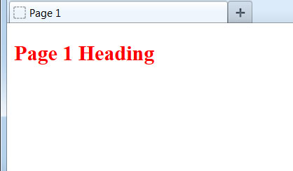

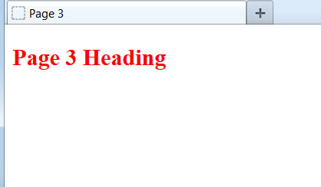
BENEFIT OF EXTERNAL STYLE SHEET
The real power of using an external style sheet is that multiple web pages on our site can link to the same style sheet:
style.css :
h2 {color:red;}
page1.html
page2.html
page3.html
Styles declared in an external style sheet will affect all matching elements on all web pages that link to the style sheet. By editing the external style sheet, we can make site-wide changes (even to hundreds of pages) instantly.

Slide 21
INTERNAL VS. EXTERNAL STYLE SHEETS
Internal Style Sheets:
are appropriate for very small sites, especially those that have just a single page.
might also make sense when each page of a site needs to have a completely different look.
External Style Sheets:
are better for multi-page websites that need to have a uniform look and feel to all pages.
make for faster-loading sites (less redundant code).
allow designers to make site-wide changes quickly and easily.
External style sheets create the furthest separation between content and presentation. For this reason - and the others listed above - we'll consider external style sheets to be the best option when creating a new site.

Slide 22
THREE CSS DEFINITION LOCATIONS
Inline: the “style” attribute
  Note, the selector for inline CSS is the tag which contains the style attribute.
Internal: the <style> markup tag
External: the .css stylesheet file
<p style=“font-color:red;font-size:10px;”>Content</p>
<html><head><style>
p { background-color: Red;
font-family: serif;
font-color: White; }
</style></head><body>
<p>Content</p>
</body></html>
<link rel="stylesheet" type="text/css" href=“mystylesheet.css" />

Slide 23
CSS SYNTAX: SELECTORS
There are many kinds of selectors and many ways to reference them:
  Type, Class, ID, Pseudo, etc.
HTML Type Tag – selected with the tag type
The Class Attribute – precede the class with a period
p { font-size: 10px;
font-color: White; }
<p>Content</p>
.myinfo { font-size: 10px;
font-color: White; }
<p class=“myinfo”>Content</p>
<div class=“myinfo”>Other content</div>

Slide 24
CASCADING INHERITANCE
Nested elements inherit
the properties from the
its parent
If you specify a style for the
<body> tag it will affect all
content in your HTML page.
If you want to override
inherited settings, you
need to specify a style in
a more local element
body { font-family: Verdana;
font-size: 14px; }
body { font-family: Verdana;
font-size: 1.1em; }
.littletext { font-size: 8px; }
<body>
This text is larger.
<p class=“littletext”>This text is smaller.</p>

Slide 25
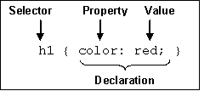
CSS SYNTAX
3 Elements to a CSS Statement
  Selector
    What HTML sections does it affect?
  Property
    What attribute of that HTML section will be affected?
  Value
    What change will be made to that attribute?

Slide 26
CSS TERMINOLOGY AND SYNTAX:
Now let's take a closer look at how we write CSS code. The correct syntax of a CSS declaration is: selector {property:value;}
p {color:red;}
selector
property
value
Internal and external style sheets use this identical CSS syntax. Internal style sheets must use the opening and closing <style> tags to surround the CSS code, while external style sheets do not use the <style> element.
A semicolon must be placed after each CSS declaration. Omitting this semicolon is the single most common mistake made by those learning CSS.

Slide 27
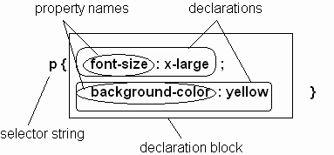
CSS SYNTAX
Parts of a style rule (or statement)
Guy-Vincent Jourdan :: CSI 3140 :: based on Jeffrey C. Jackson’s slides

Slide 28
SETTING MULTIPLE PROPERTIES
We can define as many properties as we wish for a selector:
p {color:red;font-style:italic;text-align:center;}
In this example, all text within paragraph elements will show in red italics that is centered on the page.
p {
color: red;
font-style: italic;
text-align: center;
}
Just as with HTML, browsers ignore space characters in CSS code. Many designers take advantage of this fact by placing the opening and closing curly brackets on their own dedicated lines. Each of the property and value pairings are placed on their own indented line, with a space after the colon. This makes the code far easier to read.

Slide 29
CSS TEXT PROPERTIES
The following properties can be specified for any element that contains text, such as <h1> through <h6>, <p>, <ol>, <ul>, and <a>:
Property Some Possible Values
text-align: center, left, right, justify
text-decoration: underline, line-through, blink
color: blue, green, yellow, red, white, etc.
font-family: Arial, Verdana, "Times New Roman"
font-size: large, 120%, 20px (pixels)
font-weight: bold, normal
font-style: italic, normal
The actual list of available properties and values is quite long, but the ones listed above are the most common for formatting text via CSS.

Slide 30
HOW BROWSERS PROCESS CSS
A web browser will process all CSS code it encounters, even if it is from all three methods.
For example, an external style sheet could define the font of a heading, an internal style sheet could specify the font size of the heading, and an inline style could italicize the heading. All three would be applied.
Sometimes a browser will receive conflicting instructions from the CSS code. For example, what if each of the above CSS sources specified a different color for the heading text?
Browsers need a consistent way of settling these formatting conflicts in a consistent fashion. That is where the "cascade" of cascading style sheets comes into effect.

